Slide 1
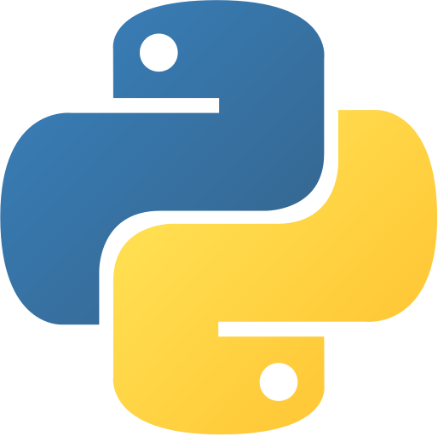
Python Lecture 3
Tanay Bhadra (message on Slack if you have questions!)
Curriculum Manager
ULAB Physics and Astronomy

Slide 2
Goal of this Lecture
Understand:
Functions
Conditionals
Loops

Slide 3
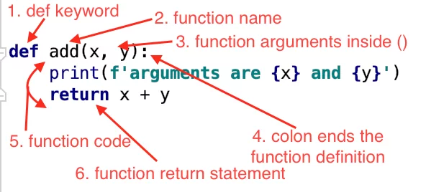
Functions
Functions perform repetitive tasks. They react to some input and produce some output.
In other words, if we want to execute a series of statements over and over, we can abstract them away into a function and avoid repeating code.
[DEMO]

Slide 4
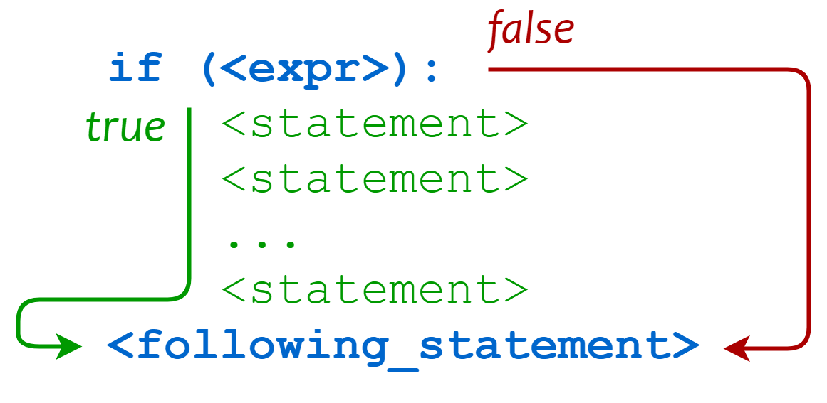
Conditionals
Conditionals are also known as control statements because they literally control the flow of your code. It has a simple structure:
Check if an expression is true.
If expression is true, do a series of actions.
If it is false, do another series of actions.

Slide 5
Loops
While loops are used to execute a block of statements repeatedly until a given condition is satisfied. When the condition becomes false, the loop stops. The statement after the condition is then executed.
For loops are used when you want to repeat a process for a number of counts, and you know how many counts this is. Unlike while loop, where you update count variable, for loop does it for you.

